Slide 1
Applied Physics NS(1001)
LECTURE # 1
DATE: 21ST AUGUST 2023

Slide 2

Classes Code

Slide 3

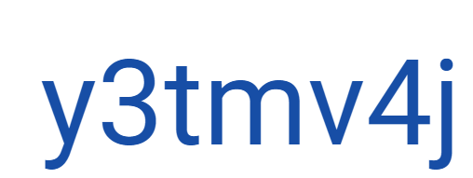
Classes Code

Slide 4

Classes Code

Slide 5


Classes Code

Slide 6
Applied Physics
Part A: Adding Vectors, Components of Vectors, Unit Vectors, Vector & Scalar Products, Position & Displacement (2/3 dimensions), Average/Instantaneous Velocity/Acceleration, Projectile Motion, Uniform Circular Motion, Newton Laws of Motion, Forces (1D/2D/3D): Gravitational, Friction, Tension, Weight.
Part B:
Simple Harmonic Motion, the Force Law for SHM, Angular SHM, Simple Pendulum, Damped SHM, Circular Motion & SHM, Types of Waves, Sinusoidal Waves, Wavelength and Frequency
Part C:
Electric Charge, Coulomb's Law, Electric Field, Electric Field Due To Point Charge, Due To Electric Dipole, Gauss' Law, Flux Of Electric Field, Cylindrical/Planar/Spherical Symmetries, Capacitance, Parallel Plate/Cylindrical/Spherical Capacitors, Capacitors In Parallel And In Series, Electric Current, Current Density, Drift Speed, Resistance & Resistivity, Ohm's Law, Magnetic Fields And Field Lines, Hall Effect, Circulating Charge Particles, Magnetic Force On Current Carrying Wire, Magnetic Field Due To Current, Ampere's Law, Magnetic Field Inside/Outside Wire/Between Parallel Wires

Slide 7
Text and Reference Books
Halliday & Resnick Fundamentals of Physics (Extended 11th Edition), Jearl Walker, © 2013 John Wiley & Sons Inc.
Physics for Scientists and Engineers with Modern Physics (6th Edition), Raymond A. Serway & John W. Jewett, © 2004 Thomson books/cole US
Physics for Scientists and Engineers (6th Edition), Paul A Tipler and Gene Mosca, W.H. Freeman and Company
Physics for Scientists and Engineers (3rd Edition), Fishbane, Gasiorowicz, Thornton, Pearson Prentice Hall.
Physics for Engineers & Scientists (3rd Edition Extended), Hans C. Ohanian and John T. Markert, W. W. Norton & Company New York. London

Slide 8
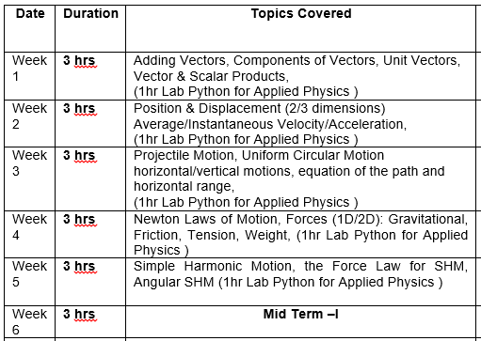
Week-Wise Course Outline

Slide 9
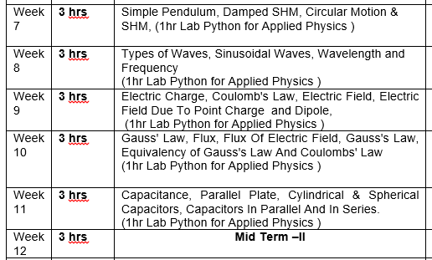
Week-Wise Course Outline:

Slide 10
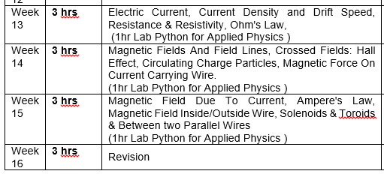
Week-Wise Course Outline:

Slide 11
Applied Physics
Marks Distribution
Midterms | 30%
Assignments | 10%
Quizzes | 10%
Final Exam | 50%
Total | 100%

